Slide 1


Spatial Analysis course
Day 4

Slide 2
11
Spatial Statistics – part II

Slide 3
10.a
Point pattern analysis

Slide 4
10.a
- Global Density
- Local Density (quadrat, kernel)

Slide 5
10.a
Global Density
10
18/100 = 0.18
10

Slide 6
10.a
5
Local Density
5

Slide 7
10.a
Local Density
(r script)

Slide 8
10.b
Distance based analysis

Slide 9
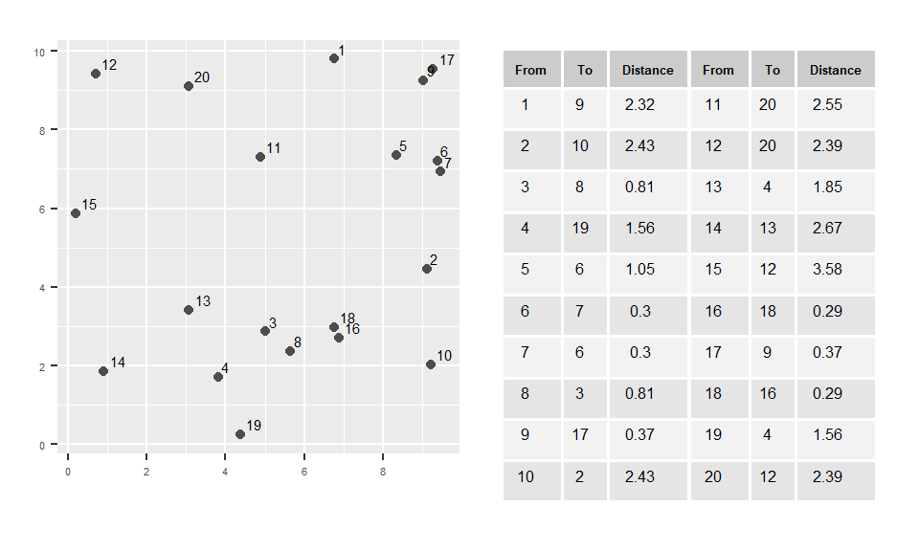
10.b

Slide 10
10.b
K function

Slide 11
10.b
K-function summarizes the distance between points for all distances.
The calculation of K is simple: it consists of dividing the mean of the sum of the number of points at different distance lags for each point by the area event density.

Slide 12
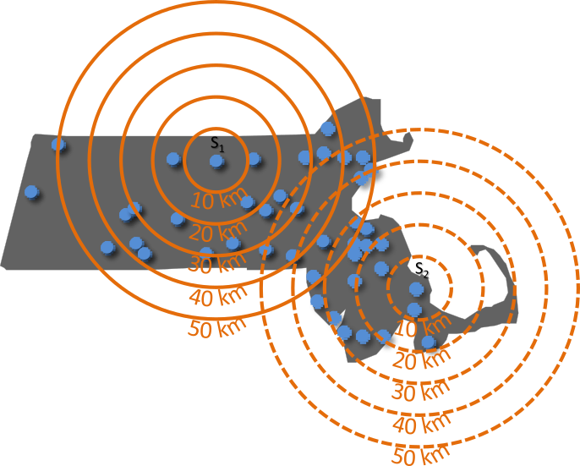
10.b
Distance r | S₁ events | S₂ events | S_{i} events | K
10 km | 0 | 1 | … | 0.012
20 km | 3 | 5 | … | 0.067
30 km | 9 | 14 | … | 0.153

Slide 13
10.a

Slide 14
10.b
L function

Slide 15
10.b
One problem with the K function is that the shape of the function tends to curve upward making it difficult to see small differences between K and Kpois.

Slide 16
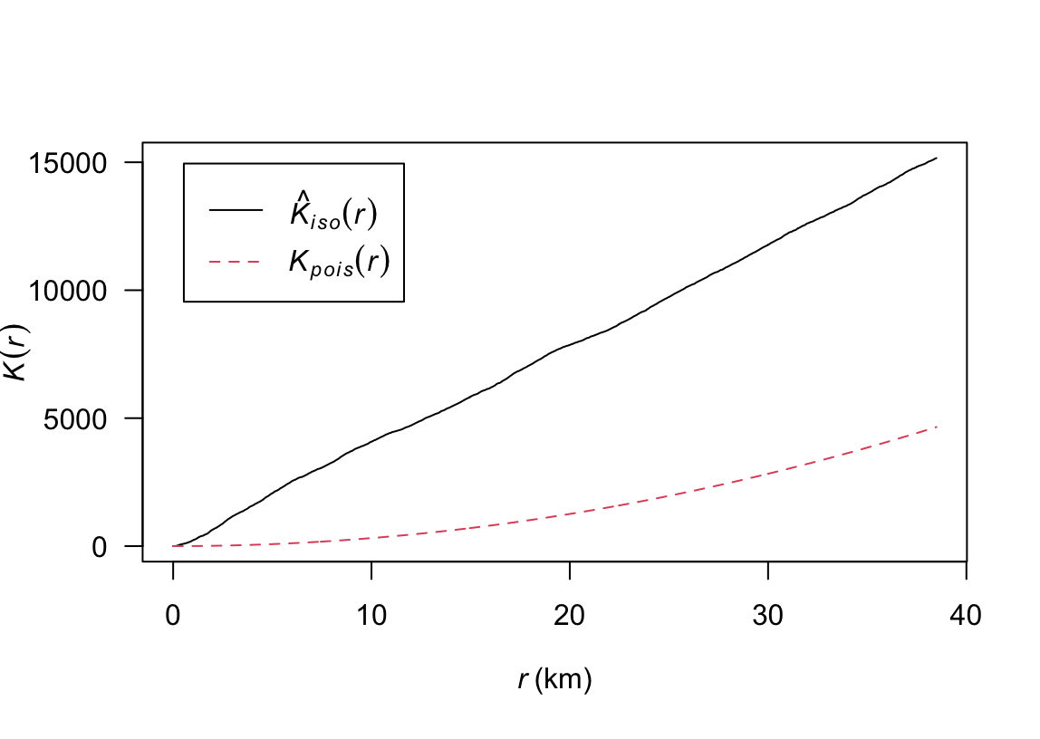
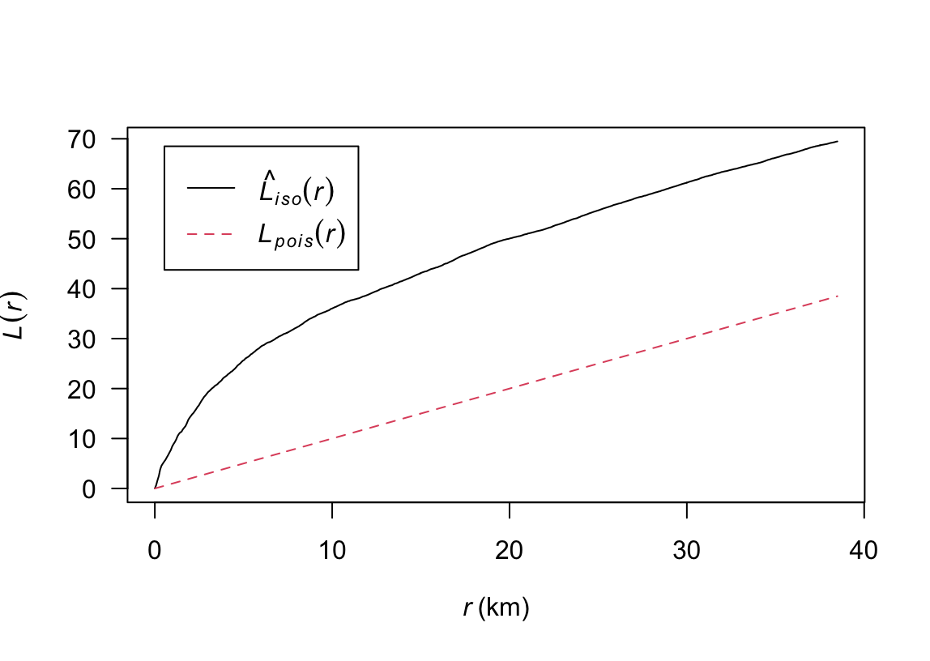
10.b
K function
L function
NOTE:
K higher than K_{pois} – points clustered at band x.
K lower than K_{pois} – points dispersed at band x.

Slide 17
10.b
The Pair Correlation Function g

Slide 18
10.b
One of the problems with the K and L function(s) is their cumulative nature.

Slide 19
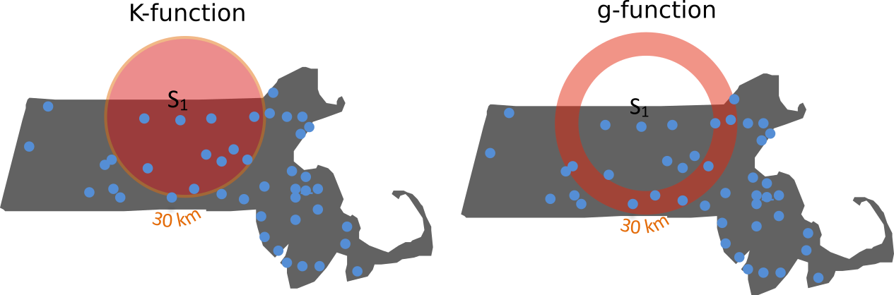
10.b

Slide 20
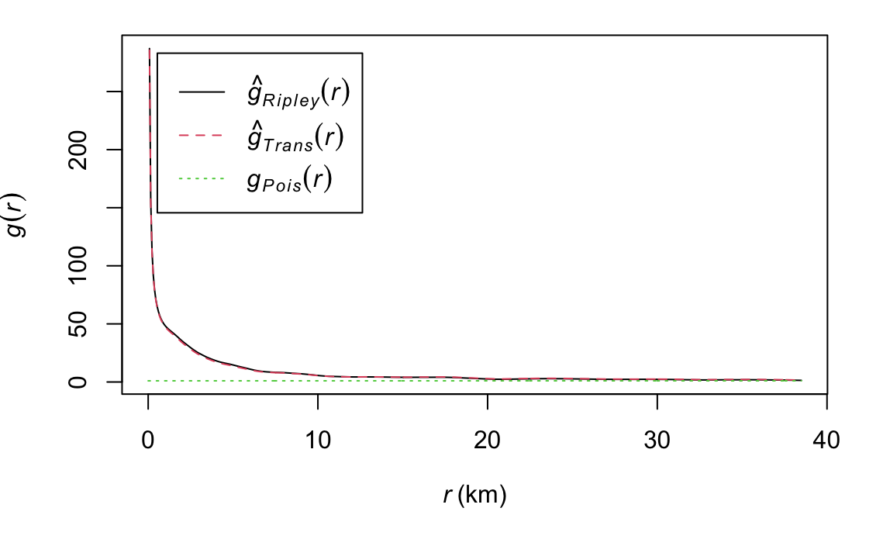
10.b
g function
NOTE:
g higher than g_{pois} – points clustered at band x.
g lower than g_{pois} – points dispersed at band x.

Slide 21
11
Network Analysis

Slide 22
11
Undirected
Directed
B
B
A
A
C
C

Slide 23
11
closeness
betweenness
degree

Slide 24
11
(rscript)

Slide 25
Thank you

